Slide 1
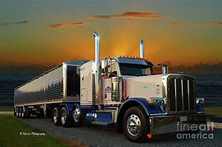

Entry Level Driver Training Information
State of Kansas

Slide 2

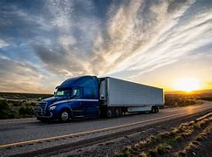
Entry Level Driver Training
Entry Level Driver Training (ELDT) Final Rule published on December 8,2016;
Compliance date of rule is fast approaching
7 February 2022

Slide 3
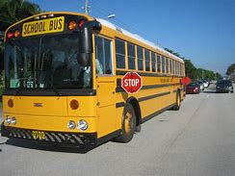
When do the entry-level driver training (ELDT) regulations take effect?
Beginning February 7, 2022, applicants must complete the training required in 49 CFR part 380, prior to obtaining any of the following commercial license credentials for the first time: a Class A or Class B commercial driver’s license (CDL); an upgrade to a Class B or a Class A CDL; or a hazardous materials (H), passenger (P), or school bus (S)
Endorsement for the first time. Driver applicants must obtain training from a training provider listed on the Training Provider Registry
Rule does not cover individuals for whom States have waived the CDL skills test under 49 CFR 383.

Slide 4
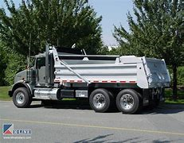
Who can provide entry-level driver training?
Training providers listed on the Training Provider Registry (TPR) are the only entities that can provide training required by the entry-level driver training (ELDT regulations). To comply with the ELDT regulations, drivers must select a training provider from those listed in the Training Provider Registry.

Slide 5
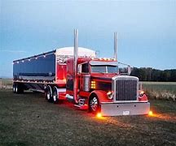
How can an entity become eligible to be listed on the Training Provider Registry (TPR)?
To be eligible for listing on the Training Provider Registry, an entity must meet the following requirements set forth in 49 CFR § 380.703:
Follow a curriculum that meets the applicable criteria in Appendices A-E of Part 380;
Utilize facilities meeting the criteria in § 380.709;
Utilize vehicles meeting the criteria in § 380.711;
Utilize instructors meeting the criteria in § 380.713;
Meet recordkeeping requirements in § 380.725;

Slide 6

Continued
Be licensed, certified, registered, or authorized to provide training in accordance with the applicable laws and regulations of any State where in-person training is conducted.
Training providers must attest that they meet the specified requirements. In the event of a Federal Motor Carrier Safety Administration (FMCSA) audit or investigation of the provider, they must supply documentary evidence to verify their compliance. Training providers must continue to meet the eligibility requirements in order to stay listed on the Training Provider Registry

Slide 7
What are CDL Applicants Required to do?
CDL applicants can complete their written CDL permit testing at any DL Office without completing the first Theory of the TPR program.
However, if an applicant wishes help in completing Theory 1 then he or she can find a TPR and received instructions to prepare them for their written exam prior to taking the knowledge test;
TPR will include all entities (including public and private CDL training programs, fleet-operated CDL training programs, etc.) that register with FMCSA and self-certify they meet the requirements for providing CDL training.

Slide 8
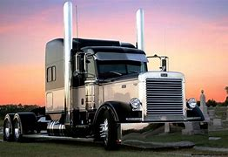
When registering, training providers will submit:
Provider name and contact information
Facility name and contact information type of provider (for-hire/not-for-hire, in-house/not-in-house)
Type of training provided, average training hours, and average training cost
Third-party affiliations, certifications, or accreditations

Slide 9
Implementation Timeline for TPR:
Summer 2021 Registration (COMPLETED)
Fall 2021 Search Feature
Shortly after search added, full function of the TPR,
2/7/2022 Required Reporting to FMCSA

Slide 10
Driver certification information submitted to the Registry will include:
Driver-trainee name, date of birth, and license/permit number and State of issuance
CDL class/endorsement and type of training completed (behind-the-wheel or theory 2)
Total number of clock hours spent behind-the-wheel (BTW) (if applicable)
Training provider name, location, and TPR ID number
Date of successful completion of training

Slide 11
Important Links for ELDT
Main Page for Training Provider Registry
https://tpr.fmcsa.dot.gov/
Main Page for Training Providers
https://tpr.fmcsa.dot.gov/Provider
Contact information for questions regarding ELDT
https://tpr.fmcsa.dot.gov/Contact

Slide 12
ELDT applies to:
Individuals:
Applying for their initial CDL
Upgrading their current CDL
Obtaining first time endorsement(s):
  Passenger,
  School bus, or
  Hazardous materials
Does not apply to anyone who started process prior to 2/7/2022

Slide 13

ELDT requirements:
Before taking the CDL skills test, an entry-level driver must successfully complete a prescribed program of instruction, including:
  Theory 1 (Classroom Training and /or Written Exam at DL Office)
  Theory 2 Behind-the-wheel (BTW)
Instruction must be provided by a school or entity listed on FMCSA’s Training Provider Registry (TPR) for Theory 2

Slide 14
ELDT Curriculum
  Rule includes five (5) separate curricula:
      Class A CDL;
      Class B CDL;
      Hazardous Materials (H) endorsement;
      Passenger (P) endorsement; and
      School Bus (S) endorsement

Slide 15
Theory 1 Instruction defined:
Theory 1 instruction must be provided by a theory instructor via:
  Lectures
  Demonstrations
  Audio-visual presentations
  Computer-based instruction
  Driving simulation devices – and/or
  Online training

Slide 16
Areas of Theory 1 Instruction:
Basic Operation
  Vehicle inspection
  Basic control
  Shifting
  Backing
2. Safe Operating Procedures
  Visual search
  Speed & space
  Distracted driving
3. Advanced Operating Practices
  Hazard perception
  Skid control/recovery
4. Vehicle Systems & Reporting Malfunctions
  Malfunctions
  Roadside inspections
  Maintenance
5. Non-Driving Activities
  Hours of Service
  Trip planning
  Handling and documenting cargo
  Post-crash
  Medical exam

Slide 17
Assessing proficiency (theory instruction)
An assessment is used to determine proficiency in each unit of instruction
No minimum number of hours
Driver-trainees must achieve a minimum score of 80 percent on the assessment

Slide 18
Theory instructor qualifications:
Theory instructors must:
Have appropriate class of CDL including appropriate endorsement(s)
Have a minimum of two years of experience:
  Driving a CMV requiring the CDL (including appropriate
  endorsement(s)) –or-
  As a behind-the-wheel CMV instructor
Meet all applicable state CMV instructor requirements

Slide 19
Theory instructor qualifications (exception):
Allows retired CMV drivers, who may have many years of experience operating a CMV but who no longer hold a CDL, to provide theory instruction
  Applies to theory instructors who previously possessed a CDL, but no longer possess a CDL
  Instructor is not required to hold a CDL as long as he or she previously held a CDL of that class and meets all other qualification requirements

Slide 20
Theory instructor qualifications (prohibition):
An individual is prohibited from providing theory instruction if his or her CDL is:
  Cancelled
  Suspended or
  Revoked

Slide 21
Behind The Wheel (BTW) Training
Actual operation of a CMV
Takes place on a range or public road
May not use a simulator to meet requirements
No Minimum number of hours, training provider will determine driver’s proficiency
Basic vehicle control skills and mastery of basic maneuvers

Slide 22
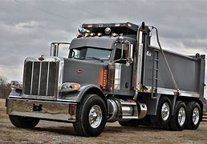
Behind-the-Wheel “Range”
Vehicle Inspection Pre-Trip/En-route/Post-Trip
Straight Line Backing
Alley Dock Backing (45 & 90 Degree)
Off-Set Backing
Parallel Parking Blind Side
Parallel Parking Sight Side

Slide 23
Behind-the-Wheel “Public Road”
Vehicle Controls Including: Left, Right turns, Lane Changes, Curves at Highway Speeds and Entry and Exit on the Interstate or Controlled Access Highway
Shifting/Transmission
Communications/Signaling
Visual Search
Speed and Space Management
Safe Driver Behavior

Slide 24
Behind-the-Wheel “Public Road” Continued
Taught but not Graded
Hours of Service (HOS)
Hazard Perception
Railroad (RR)-Highway Grade Crossing
Night Operation
Extreme Driving Conditions
Skid Control/Recovery, Jackknifing and Other Emergencies

Slide 25
Behind-the-Wheel “Public Road” Continued
Instructors must cover all topics listed and “determine and document that each driver-trainee has demonstrated proficiency in all element of the BTW curriculum unless otherwise noted”
Does not allow for “test outs” of skills training on either range or public road
Each Trainee must complete entire program to successfully operate a commercial vehicle

Slide 26
Training Requirements:
Theory 1 Classroom and Theory 2 BTW trainings may be delivered by different training providers
Both training providers must be registered/listed on the Training Provider Registry
Both training providers would submit driver training information to FMCSA
BTW range and BTW public road trainings must be provided by the Same Training Provider

Slide 27
Training Provider Qualifications:
Which can include:
  Training schools
  Educational institutions
  Rural electronic cooperatives
  Motor carriers
State/local governments
School districts
Joint labor management programs
Owner-operators
Individuals

Slide 28
Beginning February 7th 2022
Training providers wishing to provide Entry-Level Driver Training must register and self-certify that they meet all FMCSA and State requirements that apply to:
INSTRUCTORS
STATE LICENSING
VEHICLES
FACILITIES
CURRICULUM

Slide 29
Training Provider Requirements (continued)
After a driver successfully completes the required training, the training provider must Electronically submit the driver-trainee's training certification information to the Training Provider Registry.
Must be submitted by midnight of the second business day after the driver-trainee completes the training.
The Kansas DL Offices will us CSTIMS to verify and complete the process of the applicant, to ensure all training was completed before issuing a CDL Permit.

Slide 30
The Training Provider Registry
An FMCSA web system that will:
Contain the official list of Entry-Level Driver Training providers.
Retain a record of drivers that have successfully completed Entry-Level Driver Training.
https://tpr.fmcsa.dot.gov/

Slide 31
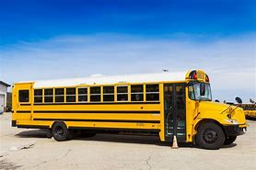
How will Training Providers Register?
Training providers will visit the Training Provider Registry to register.
One representative from each training provider completes initial registration.
Once initial registration is approved, training provider can begin listing location-specific information.
Training provider may invite additional users to enter and manage location-specific information.
Self-certification of meeting ELDT requirements may occur at training provider level, or at location level.

Slide 32
How will Training Providers Submit driver data?
Registered training provider users will log in to the Training Provider Registry and start the process to enter driver training certification information.
TPR Is Scheduled to Launch Summer 2021 (Completed)
  Optional: Transfer via TPR Web Service
  Transfer large amounts of data at one time
  Must have own IT system
  More information at:
https://tpr.fmcsa.dot.gov/DeveloperToolkit

Slide 33
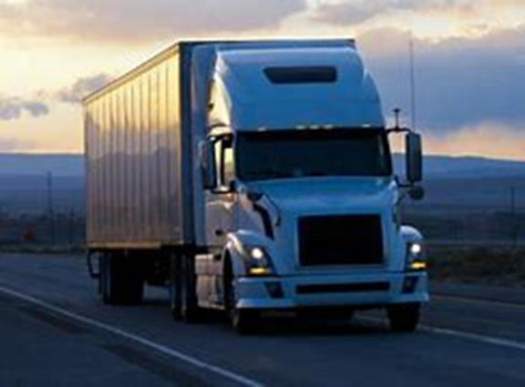
ELDT Point of contact Kansas
Mr. Brian Brunt
Kansas CDL Coordinator
1873 W. 21st St N
Wichita, KS 67203
Brian.Brunt@ks.gov
Ph 785-213-9157

